Slide 1
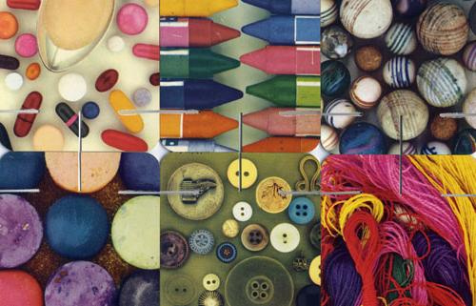
SOFTWARE AS MATERIAL
ENTERPRISE UX CONFERENCE
JUNE 8, 2016
@GPETROFF

Slide 2
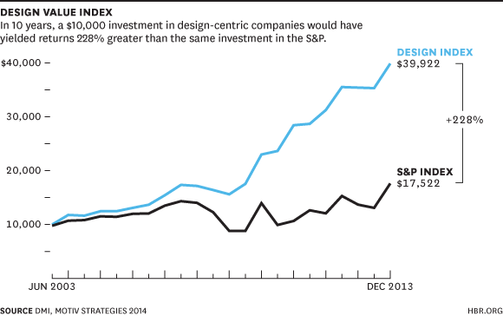
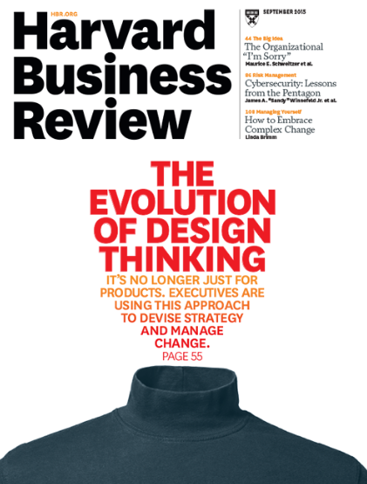
things are good…

Slide 3
we are more important then ever!

Slide 5
but…

Slide 7
emergent
MACHINE
LEARNING
IOT
SECURITY
EDGE
COMPUTE
BLOCK
CHAIN

Slide 8
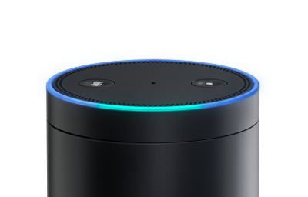
emergent
MACHINE
LEARNING
IOT
SECURITY
EDGE
COMPUTE
BLOCK
CHAIN
Go Board Game was cracked
last October…
AI advancement is blistering fast

Slide 9
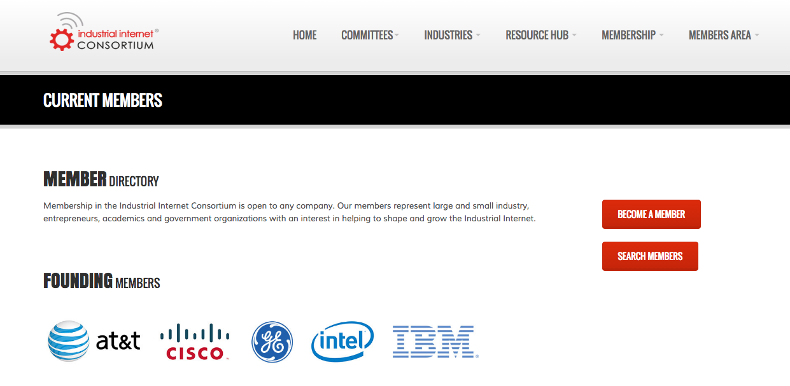
emergent
MACHINE
LEARNING
IOT
SECURITY
EDGE
COMPUTE
BLOCK
CHAIN
Internet of Things is now here
50 Billion devices each w/ an url

Slide 10
emergent
MACHINE
LEARNING
IOT
SECURITY
EDGE
COMPUTE
BLOCK
CHAIN
Secure Networks will be preferred
Humans largest source of issues

Slide 11
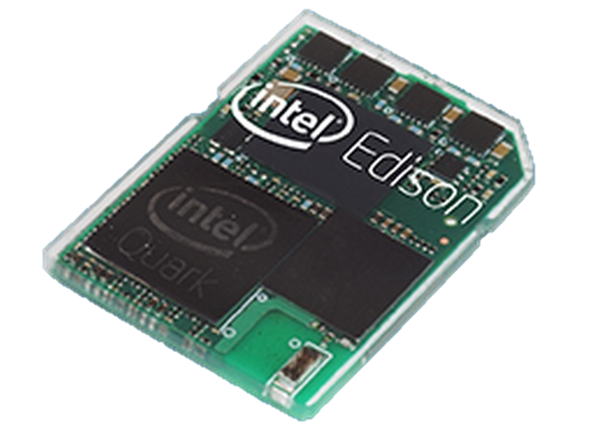
emergent
MACHINE
LEARNING
IOT
SECURITY
EDGE
COMPUTE
BLOCK
CHAIN
Why not put 100 cores on the edge?
Locale will have agency

Slide 12
emergent
MACHINE
LEARNING
IOT
SECURITY
EDGE
COMPUTE
BLOCK
CHAIN
Communal connectivity
Disrupting to FinService

Slide 13
disruptive platforms
FIN SERVICES
LOGISTICS
HOUSING
COMPUTING INFRASTRUCTURE

Slide 14
the new tech stack
PLATFORMS
MICROSERVICES
OUTCOMES
EXPERIENCE AS A SERVICE
UI TOOLKITS
SOFTWARE AS A SERVICE
REFERENCE APPLICATIONS
NEW WAY TO BUILD
PLATFORM AS A SERVICE
CHUNKS OF FUNCTIONALITY
INFRASTRUCTURE AS A SERVICE
BUILDING BLOCKS
BUSINESS MODEL AS A SERVICE
SUBSCRIPTION/SHARE ECONOMY

Slide 15
the new tech stack
PLATFORMS
MICROSERVICES
OUTCOMES
EXPERIENCE AS A SERVICE
UI TOOLKITS
SOFTWARE AS A SERVICE
REFERENCE APPLICATIONS
NEW WAY TO BUILD
PLATFORM AS A SERVICE
CHUNKS OF FUNCTIONALITY
INFRASTRUCTURE AS A SERVICE
BUILDING BLOCKS
BUSINESS MODEL AS A SERVICE
SUBSCRIPTION/SHARE ECONOMY

Slide 16
the new tech stack
PLATFORMS
MICROSERVICES
OUTCOMES
EXPERIENCE AS A SERVICE
UI TOOLKITS
SOFTWARE AS A SERVICE
REFERENCE APPLICATIONS
NEW WAY TO BUILD
PLATFORM AS A SERVICE
CHUNKS OF FUNCTIONALITY
INFRASTRUCTURE AS A SERVICE
BUILDING BLOCKS
BUSINESS MODEL AS A SERVICE
SUBSCRIPTION/SHARE ECONOMY

Slide 17
the new tech stack
PLATFORMS
MICROSERVICES
OUTCOMES
EXPERIENCE AS A SERVICE
UI TOOLKITS
SOFTWARE AS A SERVICE
REFERENCE APPLICATIONS
NEW WAY TO BUILD
PLATFORM AS A SERVICE
CHUNKS OF FUNCTIONALITY
INFRASTRUCTURE AS A SERVICE
BUILDING BLOCKS
BUSINESS MODEL AS A SERVICE
SUBSCRIPTION/SHARE ECONOMY

Slide 18
the new tech stack
PLATFORMS
MICROSERVICES
OUTCOMES
EXPERIENCE AS A SERVICE
UI TOOLKITS
SOFTWARE AS A SERVICE
REFERENCE APPLICATIONS
NEW WAY TO BUILD
PLATFORM AS A SERVICE
CHUNKS OF FUNCTIONALITY
INFRASTRUCTURE AS A SERVICE
BUILDING BLOCKS
BUSINESS MODEL AS A SERVICE
SUBSCRIPTION/SHARE ECONOMY

Slide 19
the new tech stack
PLATFORMS
MICROSERVICES
OUTCOMES
EXPERIENCE AS A SERVICE
UI TOOLKITS
SOFTWARE AS A SERVICE
REFERENCE APPLICATIONS
NEW WAY TO BUILD
PLATFORM AS A SERVICE
CHUNKS OF FUNCTIONALITY
INFRASTRUCTURE AS A SERVICE
BUILDING BLOCKS
BUSINESS MODEL AS A SERVICE
SUBSCRIPTION/SHARE ECONOMY

Slide 20
the new tech stack
PLATFORMS
MICROSERVICES
OUTCOMES
EXPERIENCE AS A SERVICE
UI TOOLKITS
SOFTWARE AS A SERVICE
REFERENCE APPLICATIONS
NEW WAY TO BUILD
PLATFORM AS A SERVICE
CHUNKS OF FUNCTIONALITY
INFRASTRUCTURE AS A SERVICE
BUILDING BLOCKS
BUSINESS MODEL AS A SERVICE
SUBSCRIPTION/SHARE ECONOMY

Slide 21
devops culture
OPS
CDCI: CONTINOUS DEVELOPMENT / CONTINOUS INTEGRATION
NO PREVIOUS VERSIONS TO SUPPORT
DEV
OPS
THE END OF THE PRD
DEV
QA
CHUNK THE PROBLEM

Slide 22
systems inversion
SYSTEMS OF RECORD
SYSTEMS OF ENGAGEMENT
SYSTEMS OF ASSETS
APP
SINGLUAR APP EXPERIENCE
APP
APP
APP
APP
APP
APP
TEMPORAL
MOMENT
APP
RELATIONSHIPS
APP
APP
SERVICES
GENUS LOCI

Slide 23
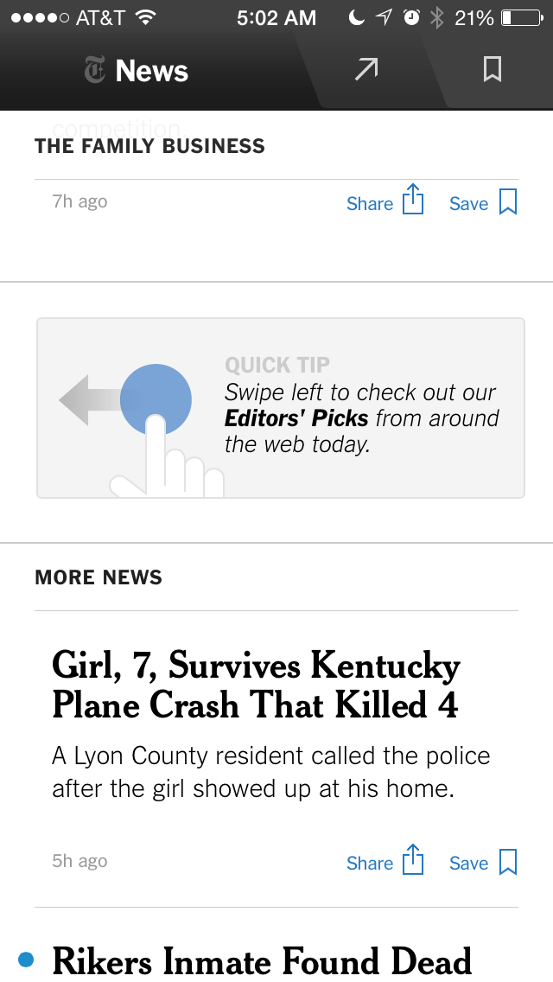
context first
ALGORYTHM’S DETERMINE EXPERIENCE
THE INTEGRATION OF DISPARATE SYSTEMS & DATA
LOCATION & TEMPORAL SERVICES
BEHAVIOR MODEL

Slide 24
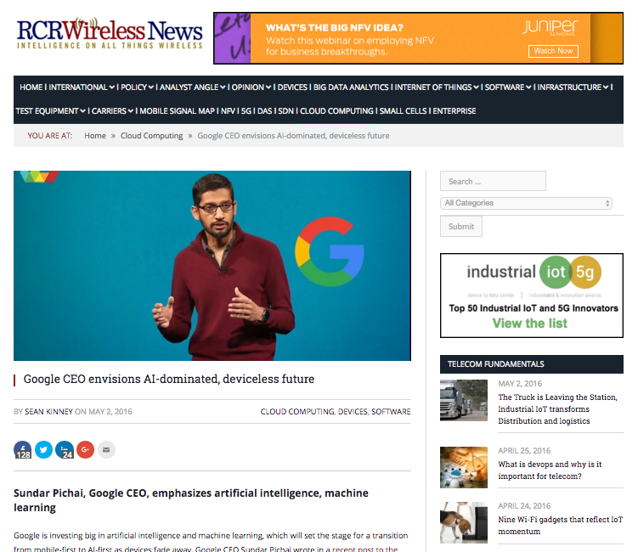

Slide 25
now what?

Slide 26
now what?
WHAT TO BUILD AND WHY?
NO ONE UNDERSTANDS THE NEW INGREDIENTS
HOW TO BUILD IS SOLVED
AMBIGUITY AND UNCERTAINTY
PREDICTION FRAMEWORK DOES NOT WORK ANYMORE

Slide 27
now what?
WHAT TO BUILD AND WHY?
NO ONE UNDERSTANDS THE NEW INGREDIENTS
HOW TO BUILD IS SOLVED
AMBIGUITY AND UNCERTAINTY
PREDICTION FRAMEWORK DOES NOT WORK ANYMORE

Slide 28
now what?
WHAT TO BUILD AND WHY?
NO ONE UNDERSTANDS THE NEW INGREDIENTS
HOW TO BUILD IS SOLVED
AMBIGUITY BREEDS UNCERTAINTY
PREDICTION FRAMEWORK DOES NOT WORK ANYMORE

Slide 29
now what?
WHAT TO BUILD AND WHY?
NO ONE UNDERSTANDS THE NEW INGREDIENTS
HOW TO BUILD IS SOLVED
AMBIGUITY AND UNCERTAINTY
PREDICTION FRAMEWORK DOES NOT WORK ANYMORE

Slide 30
now what?
WHAT TO BUILD AND WHY?
NO ONE UNDERSTANDS THE NEW INGREDIENTS
HOW TO BUILD IS SOLVED
AMBIGUITY AND UNCERTAINTY
PREDICTION FRAMEWORK DOES NOT WORK ANYMORE

Slide 31
now what?
WHAT TO BUILD AND WHY?
NO ONE UNDERSTANDS THE NEW INGREDIENTS
HOW TO BUILD IS SOLVED
AMBIGUITY AND UNCERTAINTY
PREDICTION FRAMEWORK DOES NOT WORK ANYMORE

Slide 32
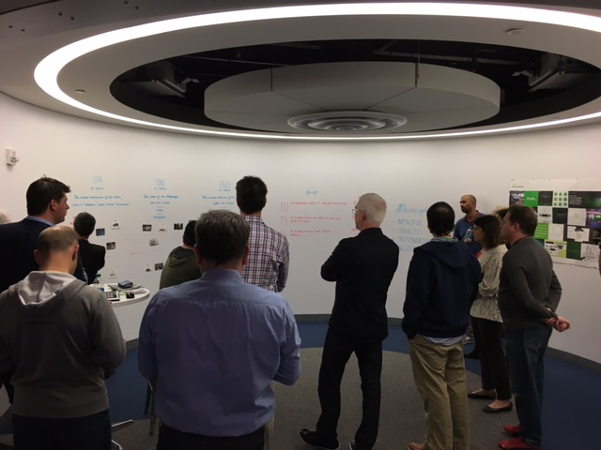
that’s what we do

Slide 33
design as core to strategy
ROLE CHANGE FOR THE DESIGNER
MAKE TO THINK OVER THINK TO MAKE
RESEARCH STILL MATTERS
ABDUCTIVE
JUXTAPOSITON
MAKING

Slide 34
design as core to strategy
ROLE CHANGE FOR THE DESIGNER
MAKE TO THINK OVER THINK TO MAKE
RESEARCH STILL MATTERS
ABDUCTIVE
JUXTAPOSITON
MAKING

Slide 35
design as core to strategy
ROLE CHANGE FOR THE DESIGNER
MAKE TO THINK OVER THINK TO MAKE
RESEARCH STILL MATTERS
ABDUCTIVE
JUXTAPOSITON
MAKING

Slide 36
design as core to strategy
ROLE CHANGE FOR THE DESIGNER
MAKE TO THINK OVER THINK TO MAKE
RESEARCH STILL MATTERS
ABDUCTIVE
JUXTAPOSITON
MAKING

Slide 37
design as core to strategy
ROLE CHANGE FOR THE DESIGNER
MAKE TO THINK OVER THINK TO MAKE
RESEARCH STILL MATTERS
ABDUCTIVE
JUXTAPOSITON
MAKING

Slide 38
design as core to strategy
ROLE CHANGE FOR THE DESIGNER
MAKE TO THINK OVER THINK TO MAKE
RESEARCH STILL MATTERS
ABDUCTIVE
JUXTAPOSITON
MAKING

Slide 39
where you are headed…
Stage 1 Today Current Enterprise
Stage 2 Tomorrow Contextual Enterprise
Stage 3 Future AI Enterprise
Process drives rewards
“Incrementalism” mindset
PRD’s
Simplification
Design Thinking & Lean Start Up Methods
Customized workflows for niche high-value processes
Multidisciplinary Strategy Teams
Customer Councils
Effective collaboration
Design thinking methods
Leverage knowledge about customers
UX Structure’s Systems
UX Teaches Systems & AI
UX Patterns Dominate
Wireframes Matter
Projects are Bespoke / Custom
Brand as an embasador
Customer Co-Innovation
Adaptive Product Development
AI Journey MapS
Successful strategy adaptation
Scenario Planning
Problem framing
Business Models Matter
Customer Centricity
Co-Creation / Make to Think
CUSTOMER JOURNEY MAPPING
UI Frameworks Make Building Easier
Focus on Reusability

Slide 40
where you are headed…
Stage 1 Today Current Enterprise
Stage 2 Tomorrow Contextual Enterprise
Stage 3 Future AI Enterprise
UX ROLE UNDERVALUED
LATE TO THE PARTY
LEARNING TO WORK W/ AGILE
TEACHABLE MOMENTS
ART OF THE POST MORTEM
YOUR SKILLS MATTER
BRAND CHAMPION
CUSTOMER HERO
IMPORTANCE ON THE RISE
WINS CELEBRATED
DELIVERING BUSINESS RESULTS
UX Structure’s Systems
UX Teaches Systems & AI
UX Patterns Dominate
WIN WITH BEST ARTIFACTS
LEARNING TO SPEAK BUSINESS
TEACHING MANAGEMENT THAT DESIGN MATTERS
PRODUCT OWNER
EVANGELisT
YOU ARE A BUSINESS PARTNER
YOU ARE A PERSUADER: KEY STAKEHOLDERS CONVERTING
MOVE TO PARTNER WITH DEVELOPMENT
CONFRONT YOUR ORTHODOXIES

Slide 41
where you are headed…
Stage 1 Today Current Enterprise
Stage 2 Tomorrow Contextual Enterprise
Stage 3 Future AI Enterprise
CRAFTSMAN
BUSINESS PARTNER
UX Structure’s Systems
UX Teaches Systems & AI
UX Patterns Dominate
INNOVATOR

Slide 42
design as core to strategy
ROLE CHANGE FOR THE DESIGNER
MAKE TO THINK OVER THINK TO MAKE
RESEARCH STILL MATTERS
ABDUCTIVE
JUXTAPOSITON
MAKING

Slide 43
design as core to strategy
ROLE CHANGE FOR THE DESIGNER
MAKE TO THINK
RESEARCH STILL MATTERS
ABDUCTIVE
JUXTAPOSITON
MAKING

Slide 44
ROLE CHANGE FOR THE DESIGNER
TO GET THERE YOU NEED TO UNDERSTAND….
MAKE TO THINK
RESEARCH STILL MATTERS
= INNOVATOR
ABDUCTIVE
JUXTAPOSITON
MAKING

Slide 45
SOFTWARE AS MATERIAL
ENTERPRISE UX CONFERENCE
JUNE 8, 2016
@GPETROFF

Slide 46
coda
EVENTUALLY EVERYTHING CONNECTS – PEOPLE, IDEAS, OBJECTS…THE QUALITY OF THE CONNECTIONS IS THE KEY TO QUALITY PER SE. UNLIKE KEATS, WHO SAID THAT KNOWING ABOUT THE RAINBOW SHATTERS ITS BEAUTY, I FEEL THAT THE KNOWLEDGE ABOUT AN OBJECT CAN ONLY ENRICH YOUR FEELINGS FOR THE OBJECT ITSELF.
CHARLES EAMES

Slide 48
thank you…
@GPETROFF

